Slide 1
Users with disabilities

Slide 2

Disabled people using computers
People with special needs should have access to computers so that they are not discrimnated.
Some users can be disabled or elderly so the design of the interface should consider these factors.
Blind people could have help by using a ‘talking computer’ or using Voice Interfaces to input data into the computer. Blind people can use Braille keyboards to type in information.
Text can be increased in size to help visually impaired people,

Slide 3
Impairments
Sensory
  Full or partial loss of: sight, hearing, touch, smell, taste
Mobility and co-ordination
  Weakened or nonexistant: limbs, back, neck, breathing, dexterity
Cognitive
  Memory (short or long term), dyslexia/dyspraxia, behavioural
And they can interact.

Slide 4
Users with disabilities
visual impairment
  screen readers, SonicFinder
hearing impairment
  text communication, gesture, captions
physical impairment
  speech I/O, eyegaze, gesture, predictive systems (e.g. Reactive keyboard)
speech impairment
  speech synthesis, text communication
dyslexia
  speech input, output
autism
  communication, education

Slide 5
… plus …
age groups
  older people e.g. disability aids, memory aids, communication tools to prevent social isolation
  children e.g. appropriate input/output devices, involvement in design process
cultural differences
  influence of nationality, generation, gender, race, sexuality, class, religion, political persuasion etc. on interpretation of interface features
  e.g. interpretation and acceptability of language, cultural symbols, gesture and colour

Slide 6
Text Input to Handheld Devices for People with Physical Disabilities
Provide text entry for people with physical disabilities
For handheld devices like Palm Pilots
  Also called Personal Digital Assistants (PDAs)
Also use Palm Pilots as interface to desktop computers

Slide 7
“EyeMouse”: An interaction device for severely motor-disabled people

Slide 8
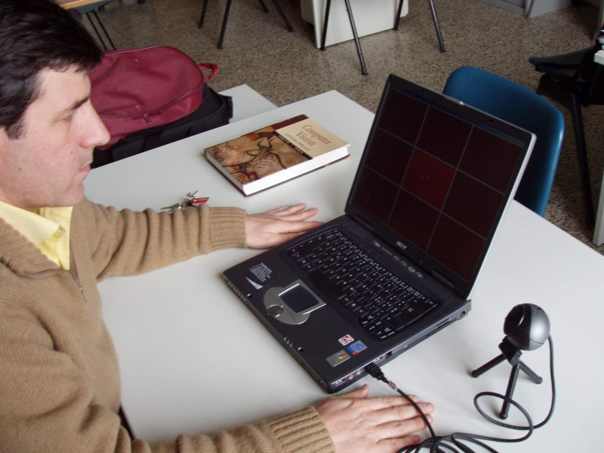
EyeMouse
Human-machine interaction system replacing the mouse with eye movements
Designed to exploit
the residual mobility of severely motor-disabled people (e.g. multiple sclerosis)

Slide 9
Interaction
User eye movements are captured through computer vision…
…and then transformed into commands for the on-screen PC interface
CV
Interpreter
Interface
commands
Live camera images
User
Screen
action
feedback

Slide 10
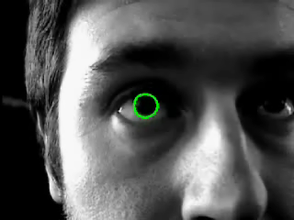
Eye capture
External eye and iris are captured by elastic template matching (snakes)
Snake template
Iris (circle)
external eye
(ellipse)

Slide 11
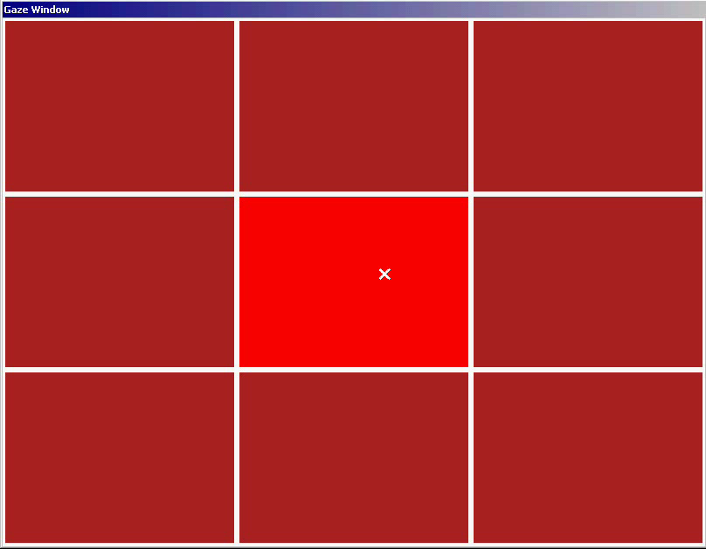
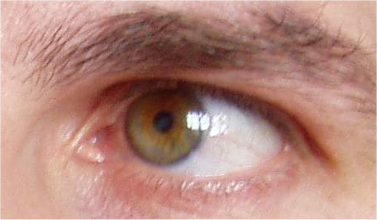
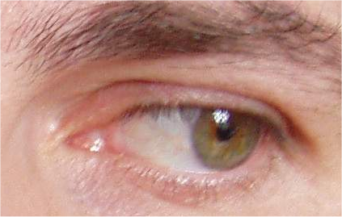
Eye remapping
Image plane
Screen plane
The iris position
in the image is remapped onto the screen plane
The image-to-screen map is calibrated at startup

Slide 12
Mouse functionalities
Navigation: eye movements
Selection: eye persistence, eye blinks
Interface feedback compensates for slight remapping errors

Slide 13
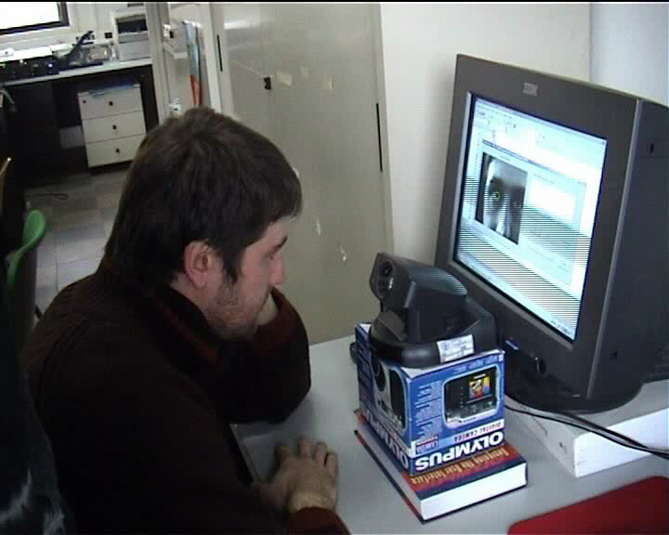

Slide 14
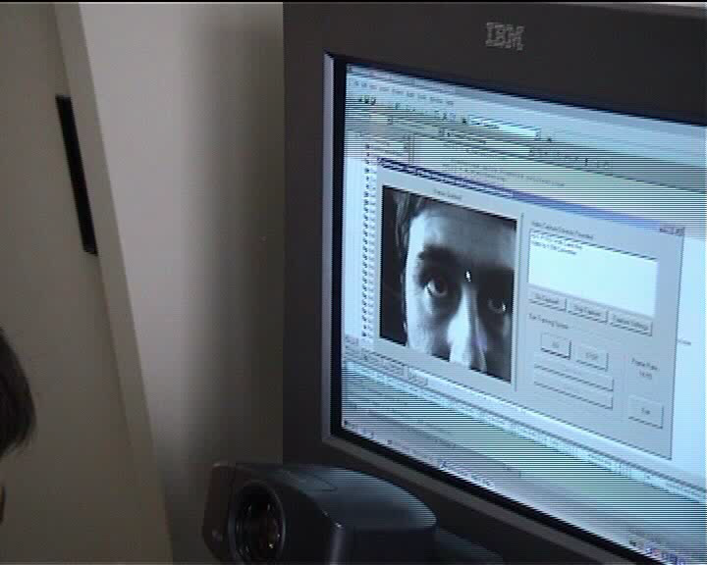

Slide 15
Scenario 1
Female old age pensioner with
  bad eyesight, but not tunnel or peripheral vision
  some short term memory problems
  some but not disabling arthritis
  extremely polite, and unwilling to question.
One to one teaching situation with you
  learning keyboard skills, leading to learning email
  keeps making mistakes
  you discover on observation that it is mostly due to missing the return key about 15% of the time.
We need a solution.
MSc E-Commerce - EE212/CE653; February 2009

Slide 16
Solutions
Build a specialist keyboard for her.
Consider voice input.
… grid input, switch input, helper
Remap keyboard – (almost) all operating systems have a key to character table.
  the cost is zero plus some time.
  it is intrinsically generalizable.
MSc E-Commerce - EE212/CE653; February 2009

Slide 17
Scenario 2
Young man whose only stable movement is with his eyes. No speech
  may be some cognitive damage
Requirement – browsing and environmental control.
You have tried head movement, switches on various body parts, joystick, all failed.
  What do we mean by failed?
MSc E-Commerce - EE212/CE653; February 2009

Slide 18
A Solution
Mytobii eye following kit, http://www.smartboxat.com/mytobii.html
  at £12k, moves curser, and blink is click.
No good for text input.
Add The Grid software, http://www.inclusive.co.uk/catalogue/acatalog/The_Grid_2.html
  at ~£300, uses multiple mappable grids, so generalizable.
  can be grid of characters, words, links, environmental commands….
  browser links are handled directly (not through The Grid).
MSc E-Commerce - EE212/CE653; February 2009

Slide 19
Scenario 3
A skilled machinist loses strength and some dexterity, wishes to continue in his job.
Numerical control (NC) machines are available.
Solution
  mapping of NC code to the appropriate HCI.
  a The Grid-like interface; later, voice control
  training the machinist in the macro system so that she can write her own.
MSc E-Commerce - EE212/CE653; February 2009

Slide 20
Scenario 4
A personal assistant acquires a heavily wasting disease. After trying many interface mechanisms, a tracker ball under the chin is chosen.
Two clamps, some wood and velcro solve the problem, along with a The Grid-like on-screen keyboard. Cost: £8.50
She retains her job.
MSc E-Commerce - EE212/CE653; February 2009

Slide 21
Scenario 4 failures
Voice input: voice too weak and variable.
multiple buttons: hand or foot fatigue.
Quadjoy http://www.quadjoy.com/ mouth operated joystick, suck is left click, blow is right click:
  intrinsic hygiene problems
  very important: personal perception of own disability
  tools that appear technically to liberate may badly effect ones perception of oneself.
MSc E-Commerce - EE212/CE653; February 2009

Slide 22
Scenario 5 and 6
Student with only peripheral vision
  puts nose on the screen, and scans with eyes
  can work for 10 minutes, then exhausted
  Solution. put screen on arm, move screen to nose. Cost, £40.
Wheelchair user in laboratory
  had very expensive ramp built to get chair safely to lab bench height.
  Solution. put lab kit on ordinary desk.
These are examples of the KISS rule.
MSc E-Commerce - EE212/CE653; February 2009

Slide 23
Scenario 7
Blind person
  no mobility problems
  no keyboard skills
  wishes full use of a computer
Solution – specialist software
  Use specialist audio feedback teaching software to learn keyboard
  Jaws or others as screenreader at £700
MSc E-Commerce - EE212/CE653; February 2009

Slide 24
Specialist software failures
Most specialist software needs to catch characters “on the way” to the screen.
  This means embedding a trap in the interrupt chain of the OS.
  Think now of needing two specialist apps. Installation can be difficult.
Reading presentation software cannot cope with pictures
  Flash (unless specially edited), pdf, etc. cannot be easily read.
  mathematics is a problem.
MSc E-Commerce - EE212/CE653; February 2009

Slide 25
Button Failures
A button is just an electrical contact.
Athetoid (shaky) powerful person breaks “disability” buttons - £20 each few days.
£350 industrial control button lasts 8 months.
53p micro-switch and two pieces of wood last about a year, and then micro-switch is replaced.
MSc E-Commerce - EE212/CE653; February 2009

Slide 26
Button Successes
Take an ordinary keyboard, and provide external contacts from keypad 8, 4, 6, 2
Connect switches to computer via game port or other interface
Use for any digital purpose.
MSc E-Commerce - EE212/CE653; February 2009

Slide 27
Voice Failures
Modern voice recognition software requires training in a voice.
Voices can change over the course of a day’s work through fatigue, for example.
Multiple scenaria solves this.
If you get angry with it, or have timing problems, it can fail.
MSc E-Commerce - EE212/CE653; February 2009

Slide 28
Making Web Pages Accessible
Cute, but not much good for blind people
MSc E-Commerce - EE212/CE653; February 2009

Slide 29
Assumptions
You know why you want a web site
You know who your audience is
You know what you want to say
You have prioritised the information you are trying to convey
You have thought out how you wish the viewers to traverse that information
WHO WHAT WHEN WHERE WHY HOW
MSc E-Commerce - EE212/CE653; February 2009

Slide 30
Navigating
Tension between
  little or no scrolling
  shallow hierarchy
In-band and out-of-band navigation
  navigation in the main body - maintenance problems
  navigation in side or top bar - frame problems
E-commerce sites need to control some navigational aims.
MSc E-Commerce - EE212/CE653; February 2009

Slide 31
Who needs access?
People with visual disabilities
People with aural disabilities
People with cognitive disabilities such as dyslexia
People
MSc E-Commerce - EE212/CE653; February 2009

Slide 32
Vision problems
Need the fonts and colours adjustable
Keep it simple
  no frames, or simple use of frames
  tables only for tabular information
  simple (and often) navigation
  ensure that there is an ALT text or alternative textual description for purely visual elements.
-- use simple backgrounds, fonts and sizes.
MSc E-Commerce - EE212/CE653; February 2009

Slide 33
Aural Problems
What can I say?
Don’t rely on sound.
MSc E-Commerce - EE212/CE653; February 2009

Slide 34
Cognitive problems
Use language correctly and simply
  It is not a bad idea not to use double negatives
Get your navigation right.
Problem
  for most people, fonts with serifs are best, for long texts.
  For dyslexics, sans serif fonts are best.
MSc E-Commerce - EE212/CE653; February 2009

Slide 35
The Big Tension
HTTP was designed to allow the user (the browser) control over the appearance, as opposed to the content, of a web page. Can be good for disability access.
Corporate users want total control over what and how the user sees and hears the material. Can be bad for disability access.
Note that this slide is bad for colour blind people.
MSc E-Commerce - EE212/CE653; February 2009

Slide 36
Political Correctness
Think that - if someone is offended by your work, then you have been offensive. Not always true, but…
Where are the limits?
  Saying nasty things about my religion
  selling exotic things like truffles. Who knows, some day they may be sold to a soldier. Soldiers are bad, therefore truffles are bad.
MSc E-Commerce - EE212/CE653; February 2009

Slide 37
To learn more..
There is a very good tool that will lead to further information. It is “Cynthia says athttp://www.contentquality.com/
It will not only actually check your site for you for accessibility, cross-browser compatibility, and speed of access,
“The source” is
http://www.w3.org/WAI/GL/
MSc E-Commerce - EE212/CE653; February 2009

Slide 38
A Simple Test
Unplug the mouse.
If the site works well from the keyboard you are successful in making an accessible sight.
MSc E-Commerce - EE212/CE653; February 2009

Slide 39
..and more..
One of the best studies of pathological HCI is Edwards, D.N., ed., Extra-Ordinary Human Computer Interaction, CUP 1995
A commercial designer (of many) with the right idea
  http://dreamink.com/design/
For an entry into the psychology, try
  http://kpope.com/
  http://www.internettg.org/newsletter/dec98/banner_blindness.html - old but useful.
MSc E-Commerce - EE212/CE653; February 2009

Slide 40
What is Web Accessibility
Web accessibility means that people with disabilities can use the Web
Disabilities including
  Visual
  Auditory
  Physical
  Speech
  Cognitive
  Neurological
  Aging-related conditions

Slide 41
How People with Disabilities Using the Web
Alternative keyboards or switches
Braille and refreshable braille
Scanning software
Screen magnifiers
Screen readers video
Speech recognition

Slide 42
How People with Disabilities Using the Web (cont)
Speech synthesis
Tabbing through structural elements
Text browsers
Visual notification
Voice browsers

Slide 43
Examples
Blind – Audio description of a video
Deaf – Captions accompanying audio
Deaf & Blind – Text description of the audio and video to refreshable braille display
Physical disability & Low vision – Speech input and speech output, and precise indicators of location and navigation.

Slide 44
Essential Components of Web Accessibility
content - the information in a Web page or Web application, including:
  natural information such as text, images, and sounds
  code or markup that defines structure, presentation, etc.
Web browsers, media players, and other "user agents"
assistive technology, in some cases - screen readers, alternative keyboards, switches, scanning software, etc.

Slide 45
Essential Components of Web Accessibility (cont)
users' knowledge, experiences, and in some cases, adaptive strategies using the Web
developers - designers, coders, authors, etc., including developers with disabilities and users who contribute content
authoring tools - software that creates Web sites
evaluation tools - Web accessibility evaluation tools, HTML validators, CSS validators, etc.

Slide 46
How the Components Relate
Web developers usually use authoring tools and evaluation tools to create Web content.
People ("users") use Web browsers, media players, assistive technologies, or other "user agents" to get and interact with the content.

Slide 47
Interdependencies Between Components
There are significant interdependencies between the components; that is, the components must work together in order for the Web to be accessible.
When accessibility features are effectively implemented in one component, the other components are more likely to implement them.

Slide 48
Guidelines for Different Components
The World Wide Web Consortium (W3C) Web Accessibility Initiative (WAI) develops Web accessibility guidelines for the different components.

Slide 49
Guidelines for Different Components (cont)
Authoring Tool Accessibility Guidelines (ATAG) addresses authoring tools
Web Content Accessibility Guidelines (WCAG) addresses Web content, and is used by developers, authoring tools, and accessibility evaluation tools
User Agent Accessibility Guidelines (UAAG) addresses Web browsers and media players, including some aspects of assistive technologies

Slide 50
Accessibility Policy
Guidelines
Learn by examples

Slide 51
Learn by examples
Blank image for skiping the navigation
ALT text for Images conveying important information
ALT text for a decorative image
  Alt = “”; not Alt = “ ”
ALT text for image maps
Heading markup
Appropriate link labels

Slide 52
Learn by examples (cont)
Accessible Audio content - transcript is provided
Avoid using color to convey information
Use Label Tag to associate Form Fields
  <label for="01"> Name (first,last)*:</label>
  <input name="textfield" type="text" id="01" size="60">
No Flashing Text

Slide 53
Learn by examples (cont)
Accessible PDFs
  Text based instead Scanned Image type PDF
  Providng links to plug-ins & add-on programs
Accessible multimedia content – captioned video
Use table headers
Accessible tables
  <td colspan="2" valign="middle" scope="col">
  <td scope="row">

Slide 54
Learn by examples (cont)
Using 'D-link' to describe images
The convention is to place a single "d" near the image that is linked to a separate page containing a description of the image.
<img src="LocMap.gif" width="387" height="432" alt="Location map" longdesc="locMapDesc.htm" > <a href="locMapDesc.htm">D</a>

Slide 55
Quick Tips
Images & animations: Use the alt attribute to describe the function of each visual.
Image maps. Use the client-side map and text for hotspots.
Multimedia. Provide captioning and transcripts of audio, and descriptions of video.

Slide 56
Quick Tips (cont)
Hypertext links. Use text that makes sense when read out of context. For example, avoid "click here."
Page organization. Use headings, lists, and consistent structure. Use CSS for layout and style where possible.
Graphs & charts. Summarize or use the longdesc attribute.

Slide 57
10 Quick Tips (cont)
Scripts, applets, & plug-ins. Provide alternative content in case active features are inaccessible or unsupported.
Frames. Use the noframes element and meaningful titles.
Tables. Make line-by-line reading sensible. Summarize.
Check your work. Validate. Use tools, checklist, and guidelines at http://www.w3.org/TR/WCAG

Slide 58
References
Web Accessibility Initiative (WAI)
www.WebAIM.org
www.cew.wisc.edu/accessibility

Slide 59
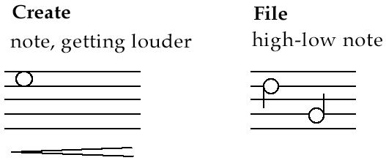
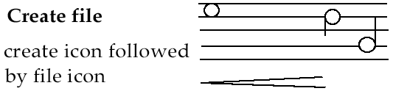
Earcons
Synthetic sounds used to convey information
Structured combinations of notes (motives ) represent actions and objects
Motives combined to provide rich information
  compound earcons
  multiple motives combined to make one more complicated earcon

Slide 60
Earcons (ctd)
family earcons
  similar types of earcons represent similar classes of action or similar objects: the family of “errors” would contain syntax and operating system errors
Earcons easily grouped and refined due to compositional and hierarchical nature
Harder to associate with the interface task since there is no natural mapping

Slide 61
What are the advantages of using sound in interfaces?
sound is a natural means of presentation
vision and hearing are interdependent
the use of sound would reduce the load on the visual senses
sound is attention grabbing
most computers have facilities for the use of sound (which is generally underused)

Slide 62
Who might benefit from the use of sound in interfaces?
users of graphical interfaces. Sound can provide extra information not displayed on the screen
visually disabled people can be guided by the use of sound
users of telephone-based interfaces; these users are totally dependent on sound
users of interfaces where eyes are busy
portable computer users, where sound can compensate for lack of screen space

Slide 63
What is the difference between Auditory Icons and Earcons?
An Auditory Icon makes use of natural everyday sounds in order to represent objects and actions on the interface. For example, as a file is dragged across the screen the noise of paper scraping can be heard.
An Earcon is a structured audio message based on musical sounds which conveys to the user information about the tasks being carried out. For example, while scrolling up and down a page the user gains information on their place in the document. At the top of the document the pitch of the note given is high; as the user scrolls down the pitch decreases.

Slide 64
Auditory learning
Auditory learning is a learning style in which a person learns through listening. An auditory learner depends on hearing and speaking as a main way of learning.

Slide 65
Example S14.1: An Earcon representing a paint file.
An Earcon representing a paint file, played with a brass timbre.
download: SHB-S14.1 (mp3, 43k)
source: Brewster, Wright and Edwards (1994)
Example S14.2: An Earcon representing the “open” operation.
An earcons representing an “open” operation, played with a piano timbre.
download: SHB-S14.2 (mp3, 38k)
source: Brewster, Wright and Edwards (1994)

Slide 66
Characteristics of Auditory Learners
. Auditory learners like to be read to.
Auditory learners sit where they can hear.
. Auditory learners are most likely to read aloud or subvocalize when they read.
Auditory learners enjoy music.
Auditory learners acquire information primarily through sound.
Auditory learners are easily distracted by noises.
Auditory learners may not coordinate colors or clothes, but can explain what they are wearing and why.
Auditory learners enjoy listening activities.
Auditory learners enjoy talking.
Auditory learners hum or talk to themselves or others when bored.

Slide 67
Why Focus on Mobile?
Most widely available ICT device worldwide –
7 billion SIM cards in service
Everything digital ends up interfacing with mobile phones, tablets or wearable wireless devices
Internet of Things: from 4.5 billion connected devices today to 50 billion connections in 2020 (Gartner Group)
Mobile devices by virtue of their embedded accessibility features are the best way for persons with disabilities to interact with their environment

Slide 68
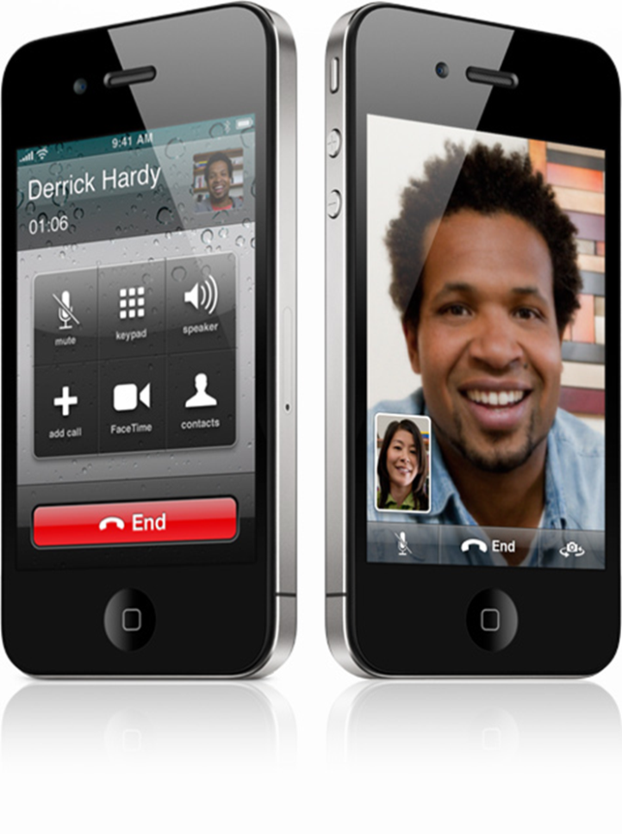
Smartphones all carry accessibility features and more intuitive interfaces for easier usage by persons with disabilities
Visual
  Text-to-Speech
Hearing
  Video Relay Service with
  sign language
Speech
  Peer-to-peer video for
  sign language
Dexterity
  Voice recognition for
  controls and input
Cognition
  Icon interface

Slide 69
Accessibility Innovation and Lower Costs Are Driven by Global Market Scale
Mobility + Networks Bandwidth + Processing Power + Memory + GPS + NFC + Camera + Gyroscope + Microphone + Biometrics + Kinetics +Miniaturization
=
Unprecedented Accessibility and Assistive Solutions Available to Persons with Disabilities
Anywhere, Anytime

Slide 70
HOW CAN CITY GOVERNMENTS LEVERAGE THE MOBILE OPPORTUNITY FOR PERSONS WITH DISABILITIES?

Slide 71
Step One: Making Existing e-Government Apps and Services Accessible to All
Persons with disabilities should have unrestricted access to the same services provided electronically to all citizens
Mobile is the most used device to access
e-government services around the world
City governments must:
  Ensure that existing e-government web sites are compliant with W3C mobile and accessibility guidelines (80% overlap)
  When developing mobile apps, ensure that they are accessible and use the embedded accessibility features of the main mobile operating systems (iOS, Android, Windows)
  Check everything digital in the city for accessibility, preferably with a dedicated organization

Slide 72

Step 2: Ensure the Accessibility of Critical Mobile Services for Independent Living
Examples:
  Public transportation systems
  Bus schedules and positioning systems are available via accessible mobile apps
  Emergency response centers
  Accept, acknowledge and respond to SMS sent by deaf callers

Slide 73
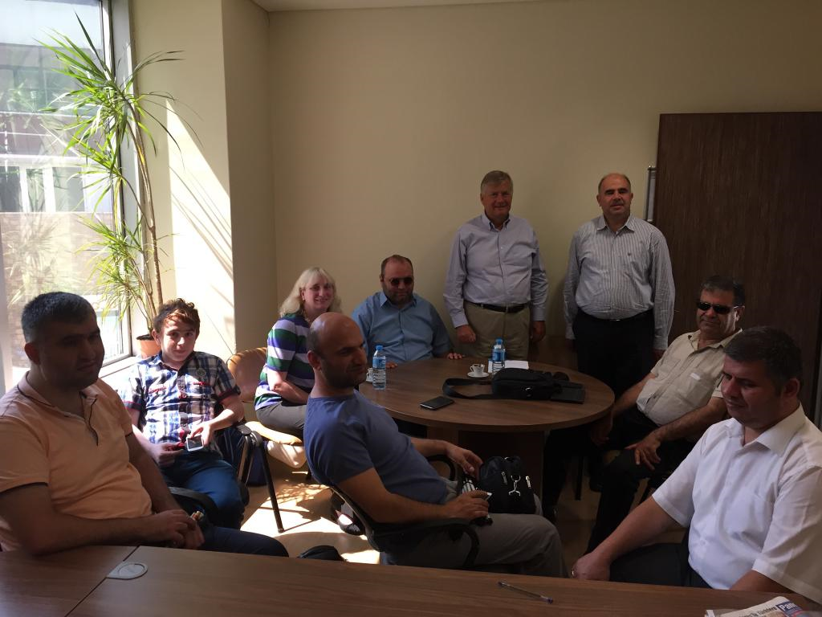
Good Practice: City of Istanbul
ICT Accessibility Commission
Constituted to guide the City in promoting the accessibility of all its e-services
Meets weekly, chaired by government official
All 7 members are IT engineers with disabilities knowledgeable on ICT accessibility, on loan by their companies
Examine web sites, apps,
transportation systems,
social services, emergency
response
Proposes and promotes
solutions

Slide 74
Step 3: Engage Civil Society in Deploying Mobile Services for Persons with Disabilities
Mobile operators: Can offer Smart Spaces technology with path finding apps and beacon technology
At home care services: Can leverage IoT technologies and remote monitoring with sensor technology to optimize safety and services
Banks: Can leverage mobile banking to better serve customers with disabilities
Grassroots organizations: Can provide disability specific crowd sourced information for physically accessible services (toilets, restaurants etc.)

Slide 75
Trends in mobile device use by people with disabilities

